Slide 1

T – Rex Runner Game
18BIT072
Mudra Bhandari

Slide 2

Slide Title
GameWindow
GameScreen
GameScreen
Creating a Game Window
Creating game screen and adding it to Game Window
Implement Thread
startGame method
GameScreen
Implementing KeyListener
GameScreen
Land
MainCharacter
Animation
Resource
Making object jump
Create class and add to screen
Create class and Implement Animation on the legs
Create Animation class to make characters run or do their respective activity
Creating resource class to get images of characters and other objects
Enemy-Cactus
EnemyManager
Cloud
Collision
State
Create and implement
Extends Enemy and overrides the methods in comfort for the enemy
Make clouds appear randomly in the sky
When Cactus and dino collides game stops.
Game Start, Play and Over State
T-Rex Runner
Add Audio
Add Score
Dead, Jump and ScoreUp audio to be put up
Add score show in the window and increase it by 20, everytime a hurdle is crossed.
Ready to play!!

Slide 3
ABOUT T-REX RUNNER GAME
A one key endless runner game which requires you to jump over the hurdles which is the most known desert plant, Cactus.
Score as much as you can!
Google Chrome provides us with this game when we are off connection to the Internet.

Slide 4
Packages | Classes | Functionality used
userinterface | GameWindow | JFrame
 | GameScreen | Jpanel AudioClip KeyListener Graphics BufferedImage URL Thread
Classes | Exception Handled
GameScreen | InterruptedException MalformedURLException

Slide 5
Packages | Classes | Functionality used
objectgame | Cactus | Graphics BufferedImage Rectangle Child class of Enemy
 | Clouds | Graphics BufferedImage ArrayList
 | Enemy | Abstract Class Graphics Rectangle
 | EnemyManager | Graphics BufferedImage ArrayList Random
 | Land | Graphics BufferedImage ArrayList Random
 | MainCharacter | AudioClip Graphics Rectangle

Slide 6
Packages | Classes | Functionality Used
Util | Animation | BufferedImage ArrayList
 | Resources | BufferedImage io.File
Classes | Exception Handled
Resources | IOException

Slide 7
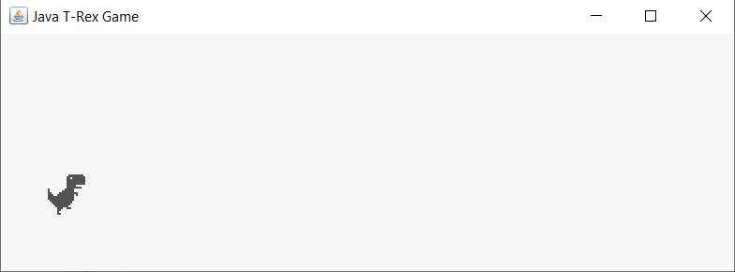
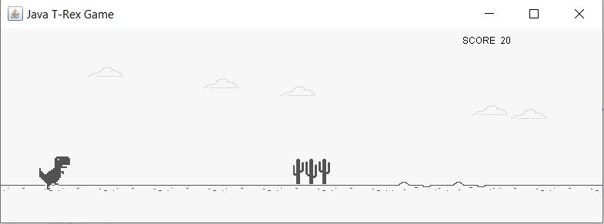
The first window that appears.
Space Bar initiates the game.
In Game Play Mode.

Slide 8
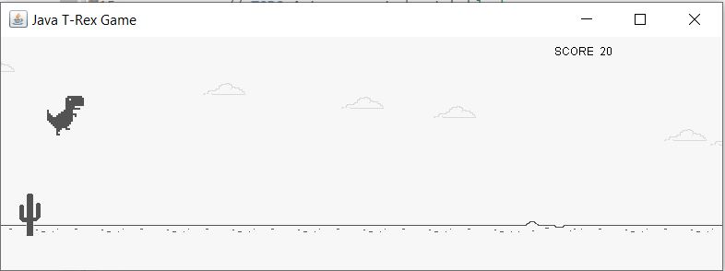
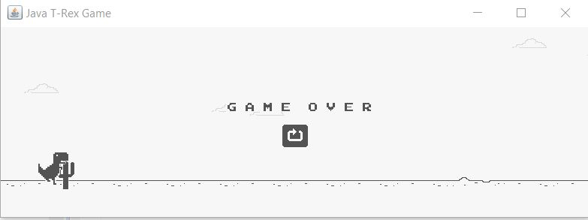
Space Bar makes the character jump.
Game Over State
Pressing Space Bar again will restart the game.

